Slide 1



Aggregate Functions
Sai Vardhan T

Slide 2
Aggregate Functions
SQL aggregate functions are inbuilt functions that are used to perform some calculation on the data and return a single value.
These functions operate on a set of rows and return a single summarized result.
Common Aggregate Functions:
count()
sum()
avg()
min()
max()
group by
having

Slide 3
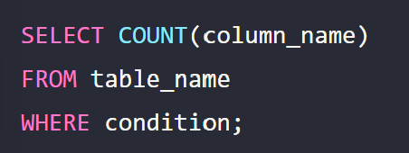
COUNT
Counts the number of rows

Slide 4
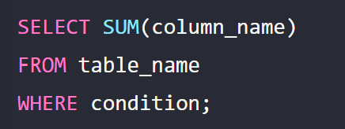
SUM
Returns the sum of a numeric Column

Slide 5
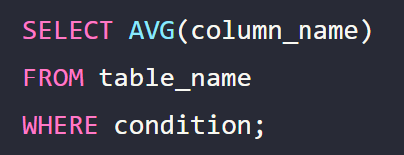
AVG
Returns the average value of a numeric column

Slide 6
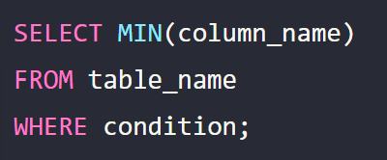
MIN
Returns the smallest value of the selected column

Slide 7
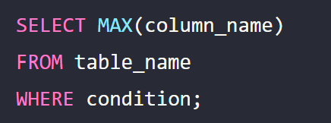
MAX
Returns the largest value of the selected column

Slide 8
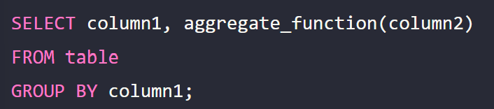
Group By clasuse
To separate the results into groups of accumulated data, you can use the GROUP BY clause.
The GROUP BY clause can be used in a SELECT statement to collect data across multiple records and group by some columns.

Slide 9
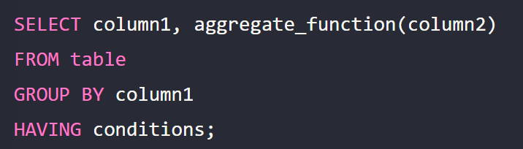
Having Clause
The HAVING clause is used with the GROUP BY clause, it applies to summarized group records, unlike the ‘where’ clause.
It was added to SQL because the WHERE keyword could not be used with aggregate functions.

Slide 10

DISTINCT
The Distinct statement is used to return only different values
Syntax:

